Slide 1
Tutorial 2 of CSC3100

Slide 2
Today’s roadmap
Array
Bubble Sort
Binary Search

Slide 3
Part 1: Array

Slide 4
Arrays Class
In Java, java.util.Arrays offer some operations to operate array, like binary search, sort, fill and so on.

Slide 5
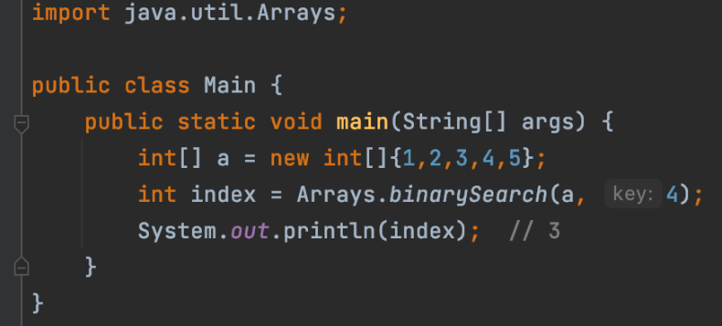
Binary Search

Slide 6
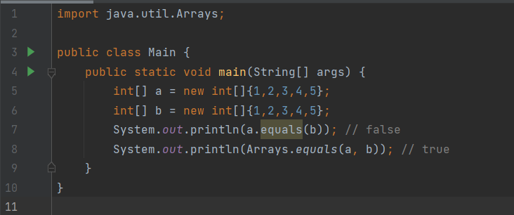
equals

Slide 7
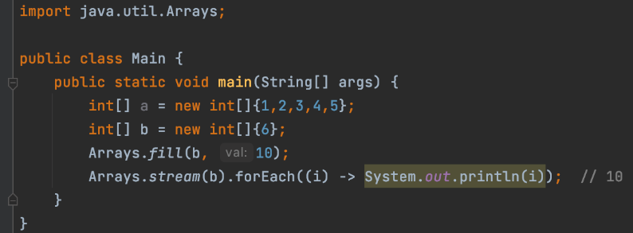
fill

Slide 8
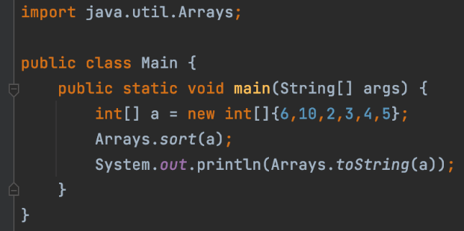

Sort

Slide 9
Part 2: Bubble Sort

Slide 10
What is Bubble Sort ?
Definition: is a simple sorting algorithm that repeatedly steps through the list, compares adjacent elements and swaps them if they are in the wrong order. (From Wikipedia)
For each iteration, at least one additional entry is put in the correct place.

Slide 11
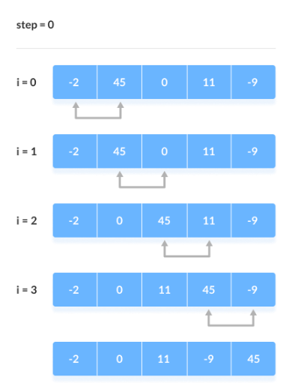
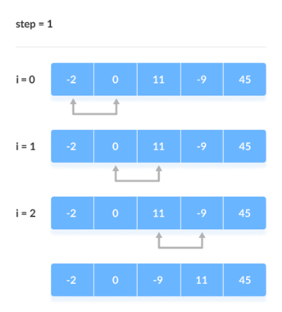
A toy example (From Programiz)

Slide 12
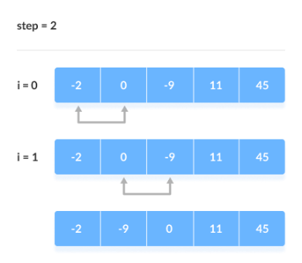
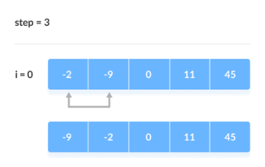
A toy example Cont.

Slide 13
Code for Bubble Sort
Download the template from Blackboard
Complete the bubbleSort function.

Slide 14
Part 3: Binary Search

Slide 15
What is Binary Search ?
Definition: is a search algorithm that finds the position of a target value within a sorted array. (From Wikipedia)
Compares the target value to the middle element of the array. If they are not equal, the half in which the target cannot lie is eliminated and the search continues on the remaining half, again taking the middle element to compare to the target value, and repeating this until the target value is found. (From Wikipedia)

Slide 16
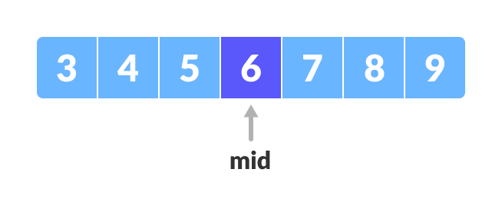
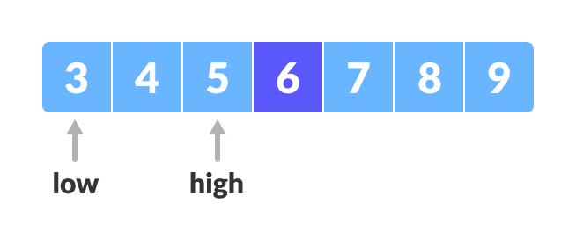
A toy example (From Programiz)
The target value is 4 and the length is 7.

Slide 17
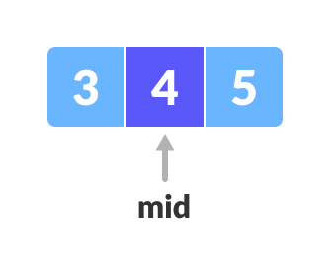
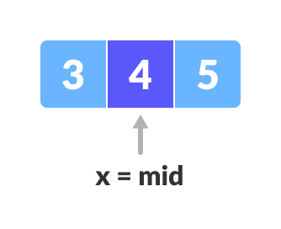
A toy example Cont.

Slide 18
Code for Binary Search
Download the template from Blackboard
Complete the binarySearch function.

Slide 19
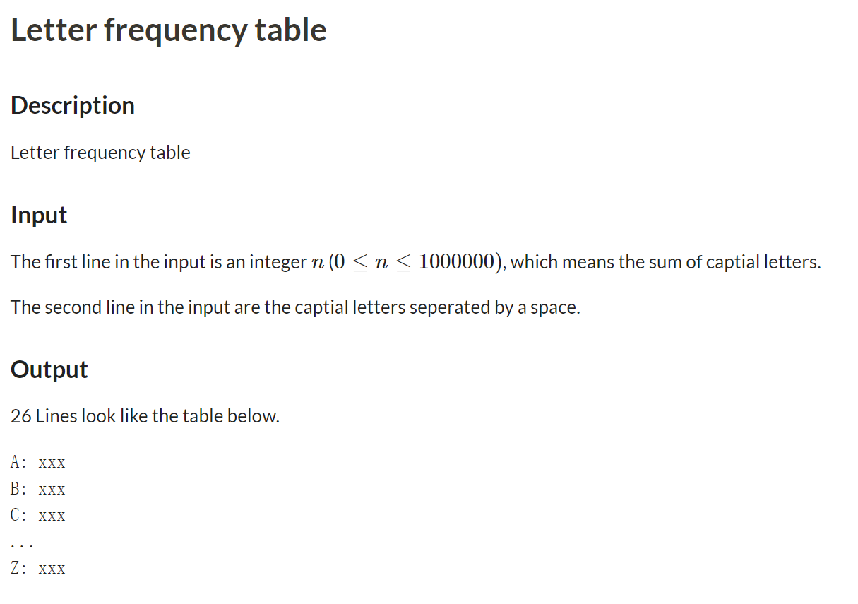

Slide 20
